Slide 1


PowerPoint 101
Prepared for: Cohort 10 All Star Training
Date: Mar 15th, 2023

Slide 2
Agenda:
Introduction
Executive summary
About Agenda
Different types of sectional summaries
Visualization
Font/typography
Appendix
Next steps
Client ready presentation

Slide 3
Presentation structure

Slide 4
Presentation Structure
Includes the results obtained in model building and recommendations based on the results
Includes the additional slides regrading the project which might come in handy and links to refer
Include the problem statement and about the data given
Business
Objective
Executive summary
Sectional summaries
Results
Next steps
Appendix & References
Introduction
Includes the introduction of team members,
About the product, About the company etc.
Includes the key insights and concise analysis of the whole presentation
Includes Profiling summary,
Modeling summary,
Results summary
Includes possible next steps that could be done for new business opportunity

Slide 5
About Introduction

Slide 6
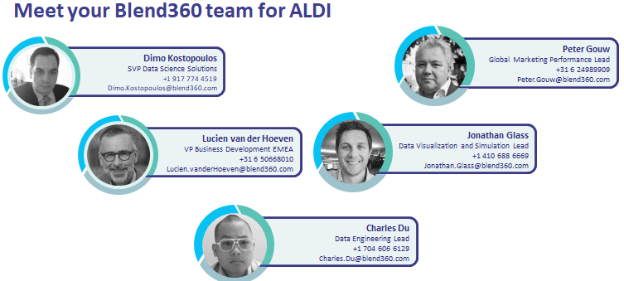
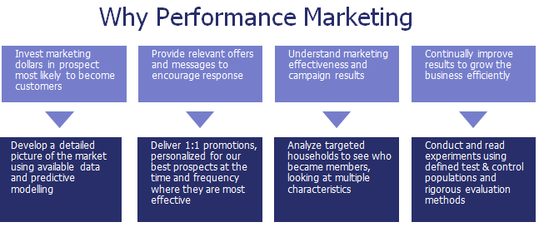
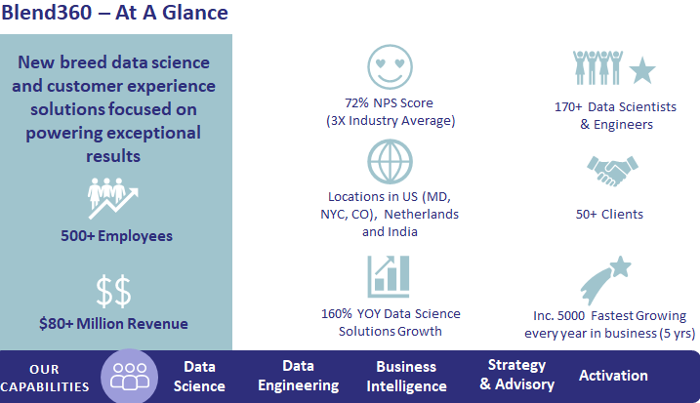
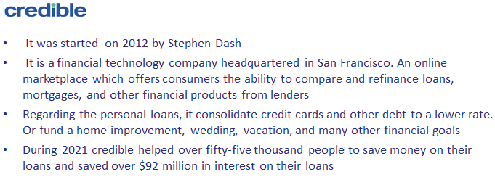
Introduction
It depends on the problem you are solving and on the audiences to whom you are presenting.
Introducing your project team members to your Client
Introducing your product or process using which you did your analysis
Introducing about your company to the Client for new business
Introducing about your Client company to the audiences

Slide 7
About Executive summary

Slide 8
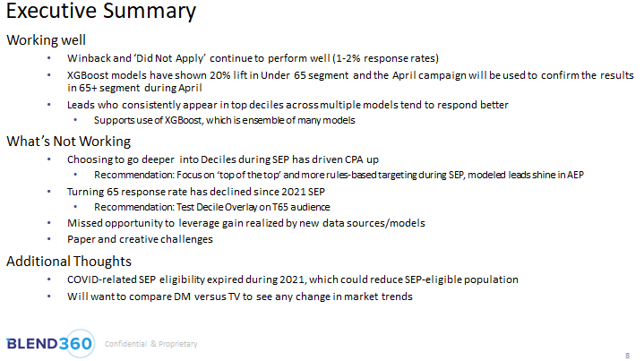
Executive summary
INCLUDES
Problem or proposal
Concise analysis
Background information
Main conclusions
It is a single slide that contains the key points from rest of the presentation. The idea is an executive who doesn’t have time to look at the whole presentation can check this single slide and get the gist of the presentation.
Concise analysis of what is working well in the whole project
Information about the factors driving the problem
Thoughts and recommendations to solve the problem

Slide 9
Executive Summary
We analyzed the relationship between inbound calls / welcome series emails and
early voluntary churn in US and Canada
Variable | Key Insights
Presence of Inbound Call | Call Group has 2.5X (US), 2.4X (CAN) churn rate compared to No Call Group
Call Timing | Calls placed early in the policy lifecycle are associated with higher churn. Customers who called after 30 (120) days have the highest churn rate in US (CAN)
Call Type | General info queries and claim calls are associated with highest churn rates
Welcome Series Emails | Spike in churn after email drops on days 2, 5, 15, 20 is observed. Customers who opened emails have higher churn than those that did not
Next Steps: Churn analysis will be extended to renewal churn. This will include analysis on churn due to anniversary price change, claim and call behavior

Slide 10
About Agenda

Slide 11
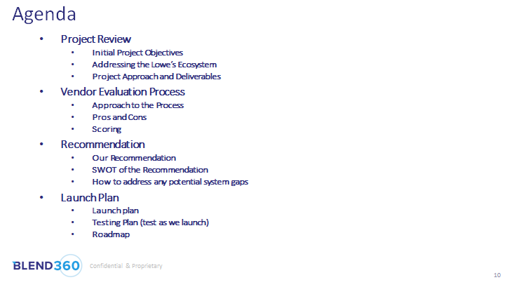
About Agenda
INCLUDES
Flow of entire presentation deck
Minute details of activities present inside the deck
Index helps you navigate through the presentation. It helps you jump to any slide in the presentation with a click. It includes the main headings of each slide and sub-headings inside the main headings if there are any. It serves as a roadmap for the meeting.
Main headings of all the activities present inside the deck. All main headings are of same font, same font size and are in bullet points.
Sub headings inside main headings to give further details about contents present in main topic. All sub headings are of same font, same font size and are in bullet points

Slide 12
About Sectional summaries

Slide 13
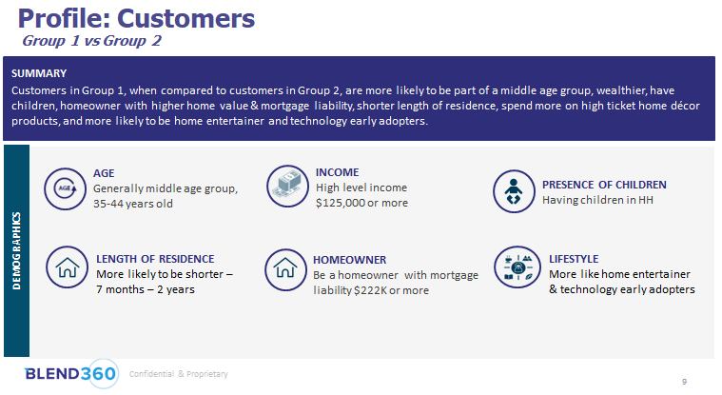
Profiling summary
Different profiling categories
Demographics
Financials
Lifestyle
Spend behaviour
It is the summary obtained by splitting a variable into categories. Continuous variables are split into ranges while categorical variables are split by unique values. It can be used to compare two populations across multiple variables, aid in constructing profiles. By this we can get good set of variables for model building.
Comparison between group 1 and group 2 based on their demographics
Summary of comparison based on Demographics attributes
Drawing insights from each demographic attribute for better comparison between the two groups

Slide 14











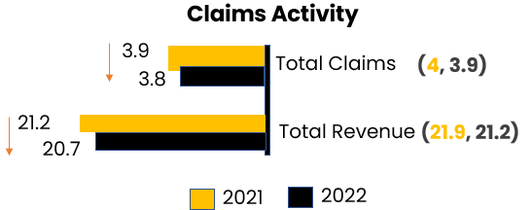







Marco – Thriving Family
Channel Preference & Interests
2.2%
Gold subscription
Low Mid High
7 months
Contactability tenure
19.1% Customers
(32k)
Purchase from direct mail
Online Purchase
Weight loss
Sports
Traveler
Reading
19% Claims in '22
47k
38% are active in ‘22
12k
High Revenue population
*[26%, 13.1%, 3.8%]
Educated and more affluent families with children. They are consumers of traditional media and do not have overly active lifestyles.
Demographics
CRM Engagement
100% Owner
(80%)
100% Presence of Children
(52%)
97% SFDU
(84%)
Low Mid High
Email Open
Email Click
Push Open
SMS
52% Female
(53%)
52 yr Avg age
(55)
60% married
(46%)
Email openers, but not as likely to take action via click. Lower engagement with push. May be direct mail responsive.
51% College
(40%)
$121k Income
1.2x
12 yr
Length of residence
(10)
Note:
* proportion of RFM clusters [2, 4, 5]
( ) indicate universe average for the variable
Total claims include refill & maintenance claims
Open rate=opens/sends ; Click rate=clicks/sends

Slide 15
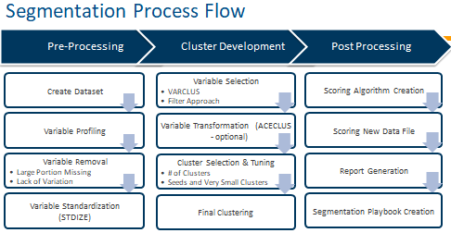
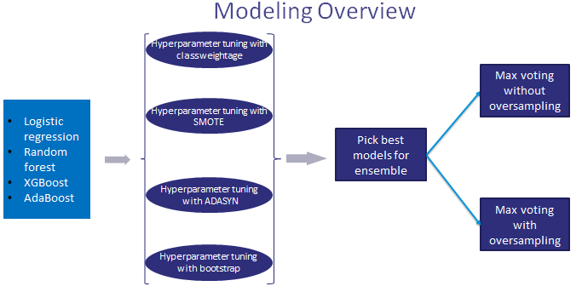
Modeling summary
INCLUDES
Process flow(methodology)
Overview of different models used
It helps in understanding the gist of modelling approach and different steps involved in the process. Also the overview of different models that are used in the process of finding the best model.
Details of sequential step to step procedure of the modelling approach and sub steps involved in different steps. Giving arrow marks helps in better understanding of flow
Overview of different models used and different techniques used to pick up the best model. Representing in the form of flow helps in better understanding

Slide 16
Analytic Methodology
We have analyzed inbound calls placed by customers during Aug 2019 – July 2020
For analysis, the following calls were considered:
Any calls that were categorized as Inbound calls based on the call dispositions
Any calls that were not matched to the phone number were excluded
Sales and uncategorized calls have been excluded
We then looked at which segment of customers who make most calls to the call center

Slide 17
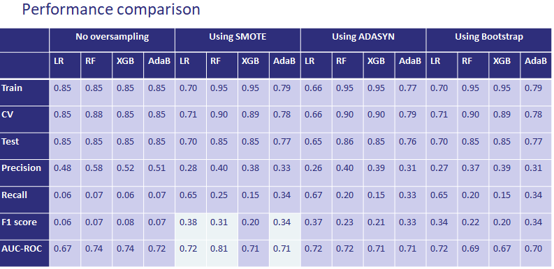
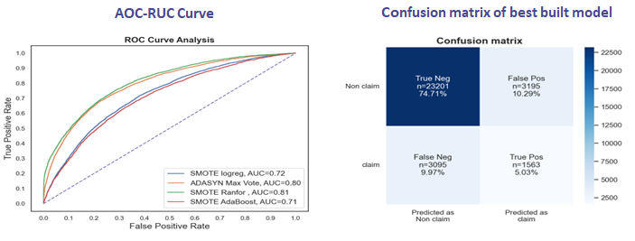
Results summary
It helps in understanding the how the different models are performed based on different metrices used and how the best model is selected from all the models. Also the retailed results of final model selected.
INCLUDES
Performance comparison
Details of final model
Performance comparison of different models based on different metrices
Showing results in the form of visualization instead of table helps in better understanding

Slide 18
Results summary
Variable Description | Importance**
More likely to have less gold net worth | 8.0%
Less likely to be economically stable* | 4.7%
More likely to be a daytime TV watcher | 3.9%
More likely to have low home market value | 3.3%
Less likely to make 20+ credit card transactions in 90 days | 2.6%
More likely to have tried quitting smoking * | 1.7%
More likely to rely on cash transactions | 1.5%
More likely to have lower income* | 1.2%
Less likely to have purchased women apparel in last 24 months | 0.8%
More likely to be a primetime TV watcher | 0.6%
Less likely to have made an online order in last 48 weeks | 0.6%
Less likely to have lived at a single address | 0.5%
More likely to have someone in the household interested in online education | 0.5%
* Identical/similar variables that also appear in the logistic regression model
** 100 variables are used in the model, so these are just the top variables

Slide 19
About Visualizations

Slide 20
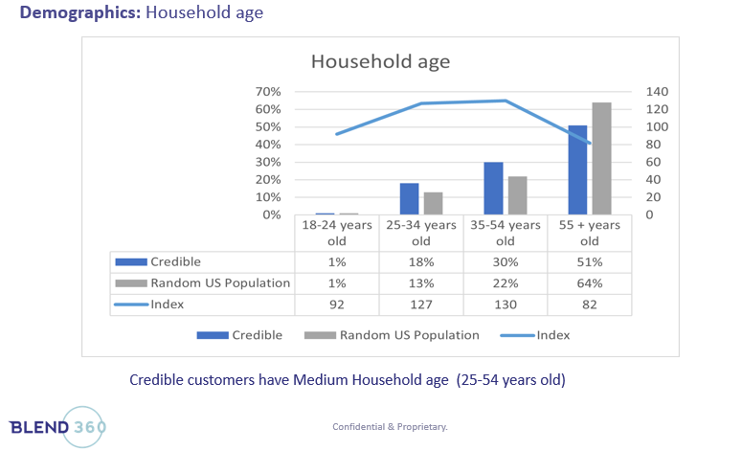
Visualizations
INCLUDES
Overall design
Overall storytelling and flow
Correct visuals, designs and color(use color to create associations like green for profit)
Highlighting key aspects
Titles, Legend, names and values
Visualizations represents faster perceptions, increased comprehension and additional context . It helps in reducing the clutter by not giving information in the form of text and numbers. It helps in focusing what is important in the entire context.
Use secondary axis whenever there is large change in the column values
Representing the data used in the chart in the form of table helps in understanding the chart better .Also numbers are in percent instead of numbers.
Describing the outcome of the chart in one sentence helps in understanding the chart better

Slide 21
Basic chart types

Slide 22
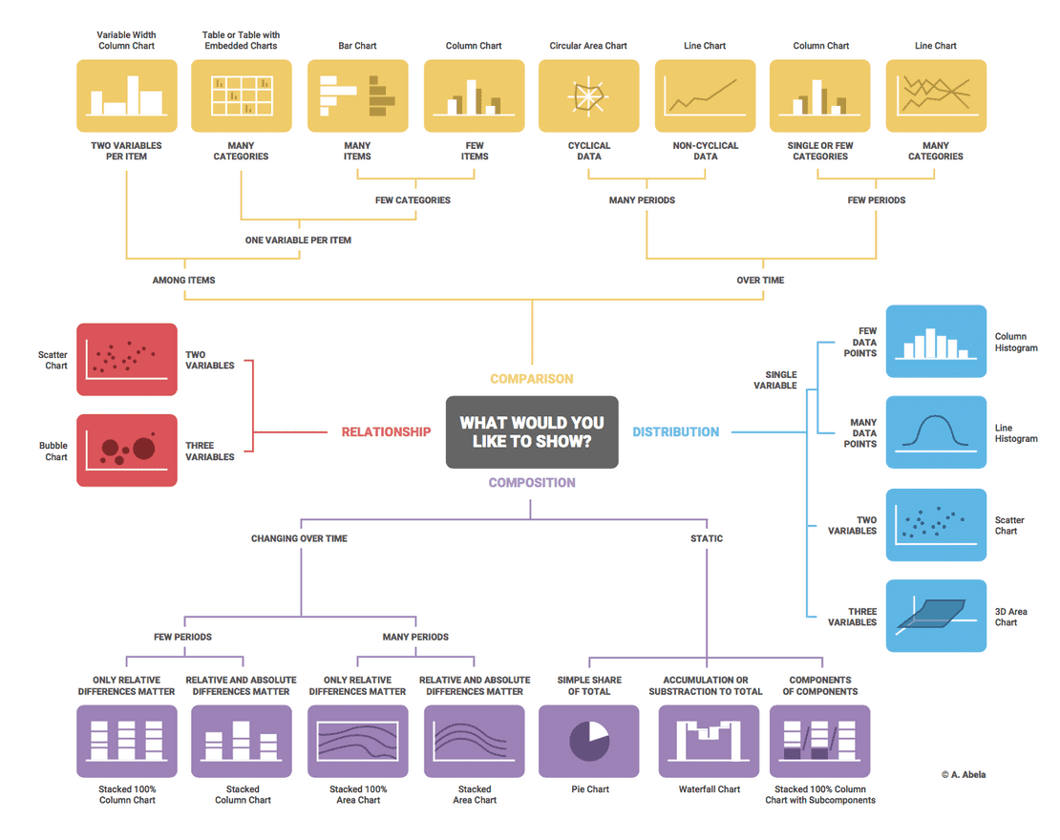
Selecting the right chart type

Slide 23
Model Lift Chart

Slide 24
About Formatting

Slide 25
Formatting
Typography
Maintain uniform font for all headings and all sub-headings across the presentation
Calibri is a commonly used font. Only use bold when you want to highlight something.
Use Calibri Bold for section titles, all caps, and emphasis on stats.
The more important the information, the bigger the font.​
Place the most important data in the top left, with secondary data following it to the right and downwards.
Use simple and easily recognizable icons and keep icon use consistent
Numbers
Numbers should be in the client currency representation(mostly US dollar) .Ex: $10,302,321
Try to provide numbers in more readable way. Ex: $10.3M instead of $10,302,321
Provide the information in percentages instead of numbers wherever it is possible

Slide 26
Color guidance
Heavily used
Sparingly used
Color balance heavy on the two primary brandcolors, and white.
Overall, a lighter approach on slideware is used, with heavier colors or photos reserved for covers and interstitial slides.
Large fields and backgrounds are white or light gray. Highlight colors are used sparingly, and for attention calling.
Two icon approaches are used: Colored outlines, or white on colored fields.
#2e2e7b
#1f95d9
#11B7BF
#ecf3f5
HEX:
#B5B5F1
#A5EBFB
#9EF8E5
#D5F5F7
HEX:

Slide 27
About Next steps

Slide 28
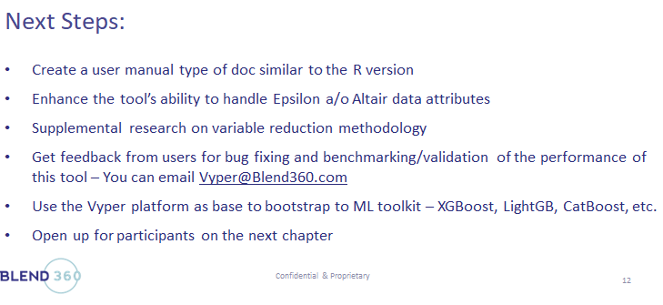
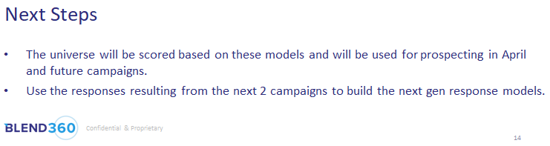
Next steps
INCLUDES
Possible next steps
Suggestions & Recommendations
It helps audience to understand what are the possible next steps could be. It possibly helps in retaining client as we tell them what are the additional work that can be done apart from the problem statement.
In this slide, presenter mentioned what are next steps in further development of Vyper tool like implementing XGBoost, LightGB, CatBoost etc apart from problem statement of implementing Python Vyper version.
Here, presenter mentioned what should be done using the models that were built. Also given a suggestion that we can build next gen response model using results from existing models(client retention).

Slide 29
Next Steps
Conduct MA plan coverage analysis to understand where Benefytt is at a competitive advantage/disadvantage in the market
Compare with segment coverage to create strategies for each market and segment
Test low quantity of key Under-Indexed Customer segments, across key demographics identified in coverage analysis
Select highest-scored DM modeled records within each
Spry Seniors: good candidates for Digital/Social overlay test
Prioritize opportunity areas (markets, customer segments)
Better understand what their needs are, what channels they consume and what messages resonate (qual research, in-market testing)
Identify areas for cross-sell/up-sell
Utilize findings in lead routing/scoring
Identify 3-5 key data elements that predict customer segment & tailor CES script accordingly
Informs which agent call gets routed to

Slide 30
About Appendix

Slide 31
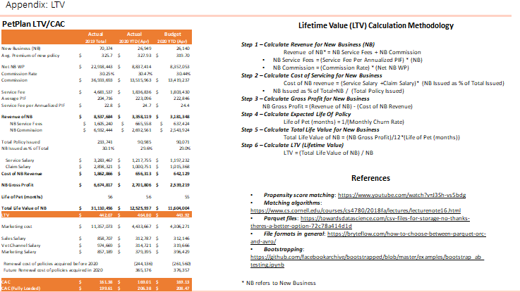
Appendix & References
INCLUDES
Mathematical calculations
Pictures
Hyperlinks
References
It contains the additional information that you want to provide your audiences outside of your presentation. It helps in the deep understanding of the concepts involved in the ppt. Basically putting everything that are of use, so that you can pull it off if audiences asks.
Includes the breakdown summary of the statement for better understanding as we just mention the end values in the main presentation
Includes the mathematical formulae's of how to calculate each and every metric for better understanding of each what each metric mean
Includes the references hyperlinks of all the concepts included in the ppt for deep understanding of concepts

Slide 32
Client ready presentation

Slide 33
Client ready presentation
Keep it Simple
Know Your Audience: Structure & Flow
Limit Bullet Points & Text
Limit Transitions: only use when applicable
Use high-quality graphics (png vs. jpg)
Use Appropriate Charts
Start with an Agenda
End your Presentation with Next Steps
Maintain uniformity across the deck
Practice & Rehearse
Stick with the Blend360 Template

Slide 34


Thank You
We Blend in to Create Results that Stand Out

